Slide 1
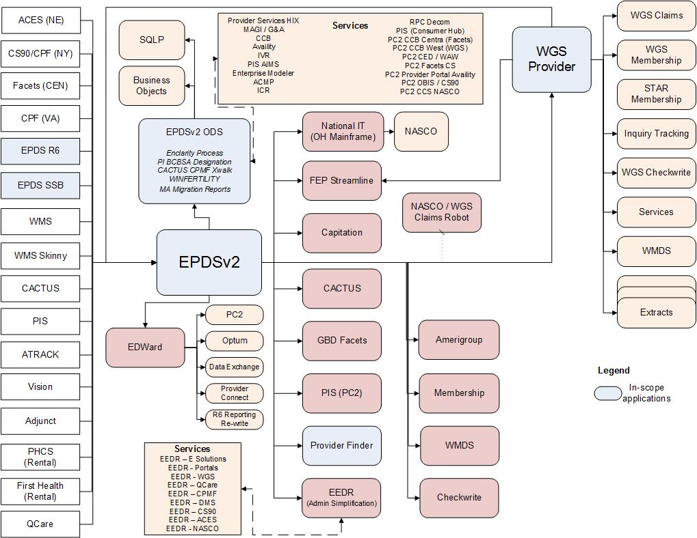
Scope of Proposal
Our Understanding

